Slide 1
Track-While-Scan
(TWS)
Notes:
Everyone signed for books?
Marine Options - This class may be optional for you.

Slide 2
Learning Objectives
Comprehend concepts of TWS system
Know the basic functions of a TWS system

Slide 3
Problems
Dedicated fire control(FC) radar can only track one target.
Systems usually have separate Scanning and Tracking Radars.
The target knows it’s being tracked.
The target can initiate Counter Measures
Weapons home in on FC radar
Notes:
EP = Electronic Protection
EA = Electronic Attack
[ ...and then ES = Electronic Support ]

Slide 4
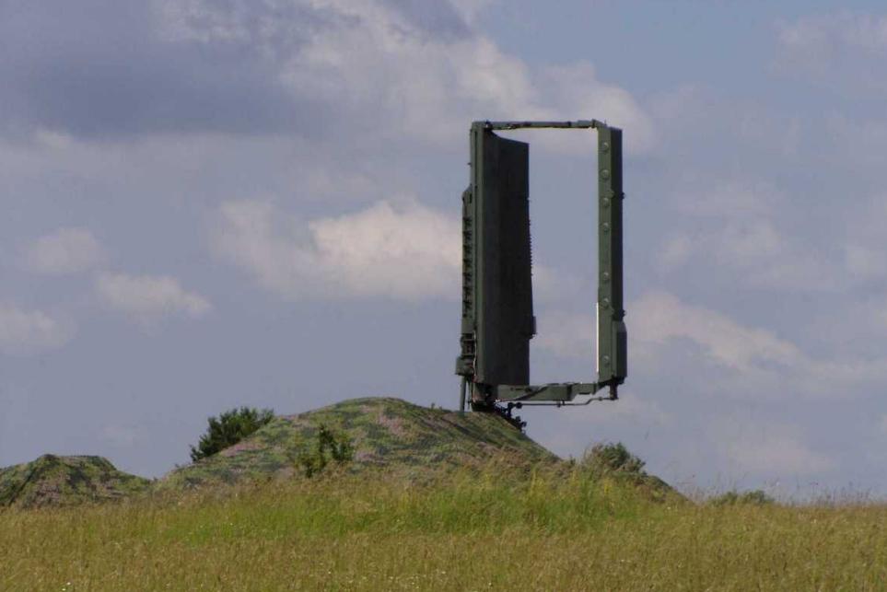
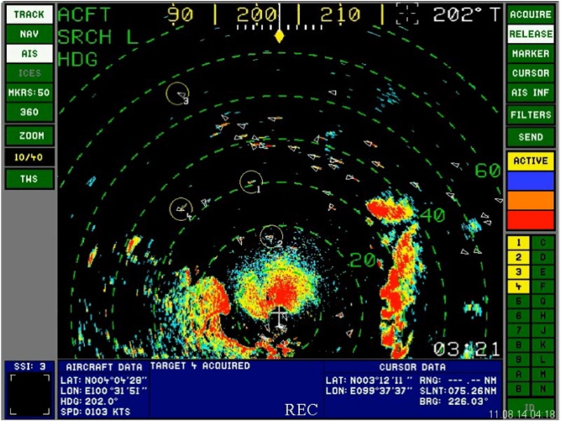
Concept of TWS
Maintain Target tracks in a computer
Periodic updates from a scanning radar
ST68UM „36D6”
Notes:
1. Maintain target tracks in a computer with periodic information updates from a scanning radar.
2. Get a search radar that can “help” solve fire control problems.
3. Sensor continues to perform primary function of search (scanning) and data input.
4. Computerization allows the system to perform a target tracking function.
5. Eliminates process of target designation from search radar to fire control radar.

Slide 5
Functions of TWS
Target detection
Target track correlation and association
Target track initiation and track file generation
(if no correlation)
Generation of tracking "gates“
Track gate prediction, smoothing (filtering), and positioning
Display and future target position calculation

Slide 6
Detection
Takes the scanning radar output, does analysis of the information and determines if the returns are from a target or just random noise.

Slide 7
Predict future target position
Uses information to predict mathematically where the target will be. Eliminates the feedback problem of always lagging the target.
The method of predicting the next scan track data is the Kalman filter.

Slide 8
Correlation
The track updating process typically begins with a procedure that is used to choose the best observation to track association. This procedure is known as data correlation and is conventionally comprised of two steps called gating and association.
most data association methods utilize gating in order to reduce later computation.
The use of Kalman filtering, with the associated covariance matrix, is assumed.
In a dense target environment additional logic is required when an observation falls within the gates of multiple target tracks or when multiple observations fall within the gate of a target track.

Slide 9
Cnt…
the data association step is then carried out to complete the assignments and resolve ambiguities.
The fames data association algorithm global nearest neighbor (GNN) handles this problem.

Slide 10
Track Initiation and file generation
(if a new target)
If it is a new target, the computer will start a file on that target. In the file it puts the position information on the target and will update the information with each subsequent scan.

Slide 11
Tracking “Gates”
Gating is a coarse test for eliminating unlikely observation-to-track pairing.
A gate is formed around the predicted position.
All measurements that satisfy the gating relationship fall within the gate are generated a cost matrix and are considered for track update.

Slide 12
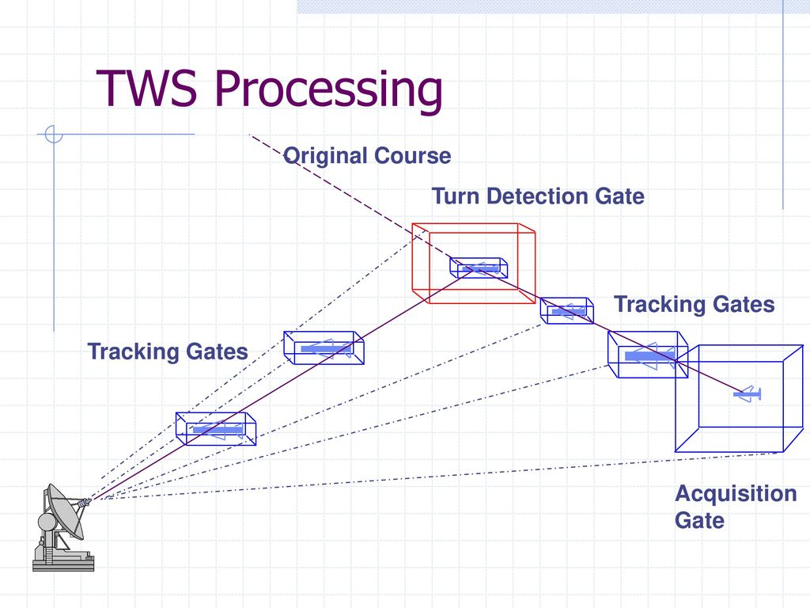
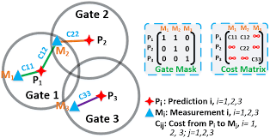

Slide 13
Gate prediction, smoothing and positioning
tracking errors were generated as a result of the target moving off the antenna axis.
tracking errors also exist due to target motion.
The tracking gate now has replaced the "tracking antenna," and this gate must be positioned dynamically on the target.
This repositioning and smoothing must be done mathematically within the TWS algorithm.
To this end, smoothing and prediction equations are employed to calculate the changing position of the tracking window.
The classic method of smoothing track data is the Kalman filter.

Slide 14
TWS Diagram
Scanning radar
detects a target
Do
parameters match
those from previous
scan
Yes
Does
track ambiguity
exist
Yes
Resolve
ambiguity
NO
NO
Generate an
acquisition
gate
Generate a
new track file
& store data
Generate
Track Gate &
indicator in file
Compute
target tracking
parameters
Acquisition
Ready for the
next radar scan
information
Reposition track
gate centered on
future position
Target
previously in track
or acquisition
Recompute
track gate
Update
tracking
parameters
Track
Notes:
1. Track parameter storage, predicted track, gate determination, past history are all performed by computers which receive information from the scanning radar.
2. You can’t talk computers without a flow chart so here it is as a review.
Show slide. And explain what the tracking computers do.
- Show that this process can work for multiple contacts.

Slide 15
TWS Radar System Advantages
Scan and Track on same system
Tracking information used for computation of a fire control solution.
Immediate Fire Control Solution
Notes:
Stress the following:
a. Search radar searches and identifies contacts (uses previous sweep’s information to determine if each return is that of a contact that is being tracked or is a new contact).
b. Only when going to use a weapons system is a fire control radar and launcher system assigned. The target’s position and track information
is then shared from the tracking computer.
c. This allows continuous track on targets but receives the fine tuning of the target of interest’s parameters to the Automatic tracking system of the angle-tracking servo, feedback enhanced for fire control radar.

Slide 16
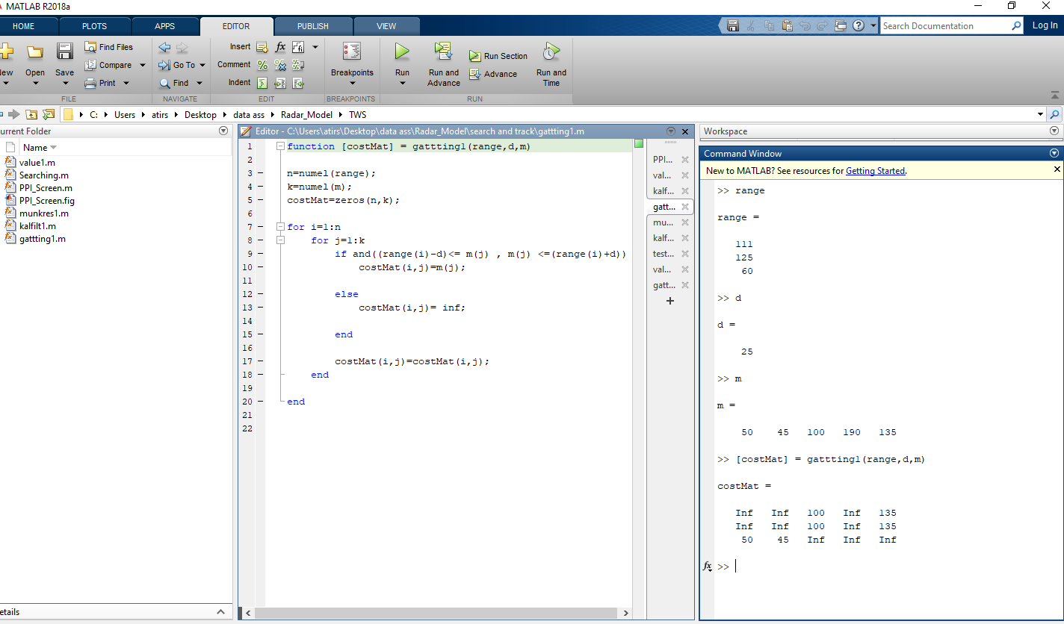
Discussion and Result

Slide 17
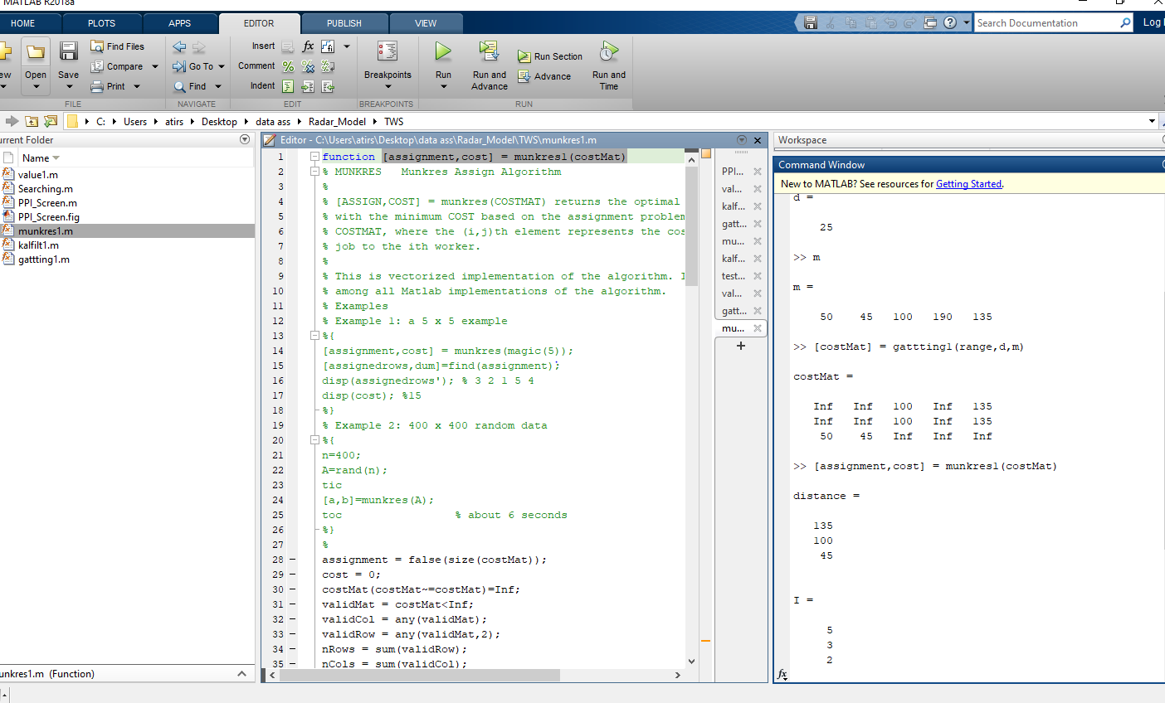

Slide 18
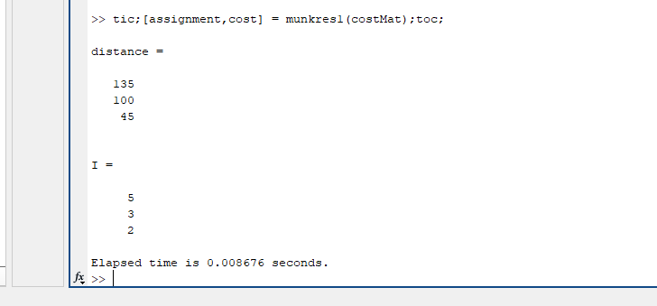

Slide 19
Summary
Radar continues scanning
Computer predicts positions
Track while Scan!
Track information used for fire control solution.

